Slide 1

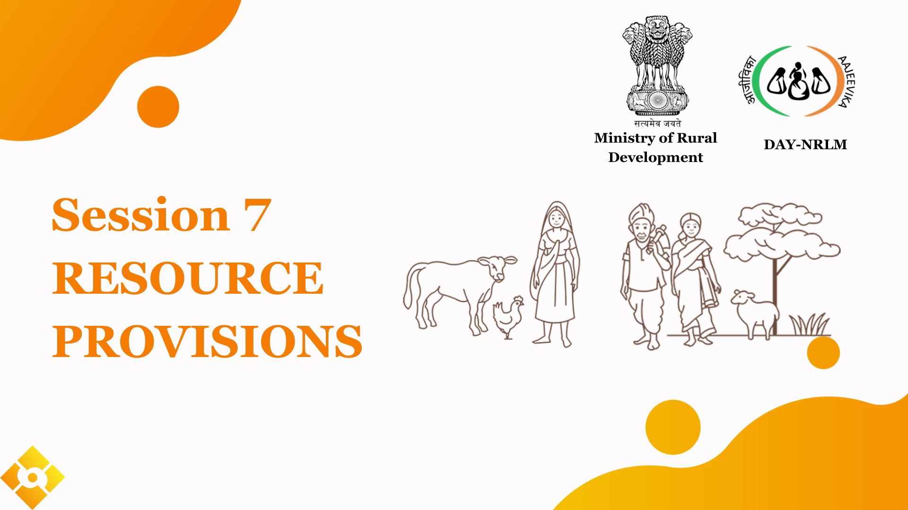



Session-7
Resource Provisions
Notes:
This section will focus on understanding the concepts and elements of sustainable livelihoods.

Slide 2


Resource Provisions
Technical Resource- knowledge, Skills
Financial Resource- Assistance, Loan, Subsidy
Resource Provisions
Convergence
Examples
Questions

Slide 3
Resource Provisions
DAY-NRLM
Schemes of Department of Rural Development
Resource Envelope
Banks/ Financial Institutions
Schemes of Other Ministries/ Departments
Private Sector
Resource Provisions
Convergence
Examples
Questions

Slide 4
Resource Provisions- DAY-NRLM
FARM LIVELIHOOD | NON FARM LIVELIHOOD
Mahila Kisan Sasaktikaran Pariyojana (MKSP) Integrated Farming Cluster (IFC) PG/PE/FPO Promotion Organic Certification Sub-sector promotion Special or innovative projects. Etc. | Micro Enterprise Development (MED) Start up Village Entrepreneurs Programme One Stop Facility Centre Product and Sectoral cluster Promotion Incubator
Resource Provisions
Convergence
Examples
Questions

Slide 5
Resource Provisions- Rural Development
SCHEMES
MGNREGS | Income Generating Asset (List of Works)
NRLM | Inclusion of poor, Livelihoods and Financial Inclusion
DDUGKY | Skilling Rural Youth, Certification and Placement
RSETI | Self Employment and Entrepreneurship
Resource Provisions
Convergence
Examples
Questions

Slide 6
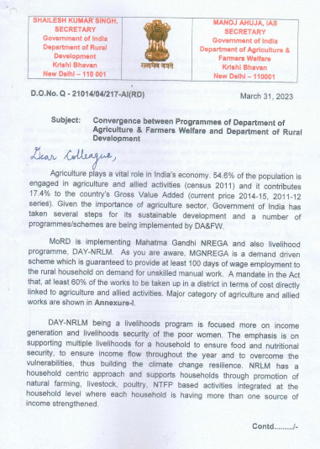
Resource Provisions- Other Ministry Schemes
Convergence- Ministry of Agriculture
Mission for Integrated Development of Horticulture (MIDH), Sub-Mission on Agriculture Mechanization (SMAM), National Bamboo Mission, National Mission on Honey and Bee Keeping, Promotion of Millets, Pradhan Mantri Krishi Sichayi Yojana (PMKSY), FPOs under 10K FPO scheme, Agri Infra Fund (AIF) etc.
Click on the image to download
Resource Provisions
Convergence
Examples
Questions

Slide 7
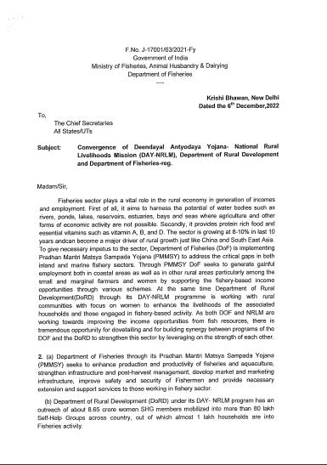
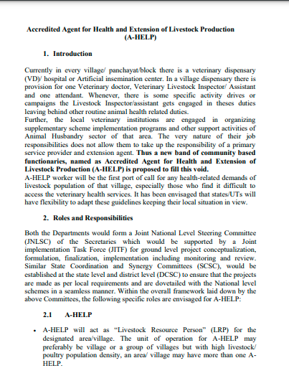
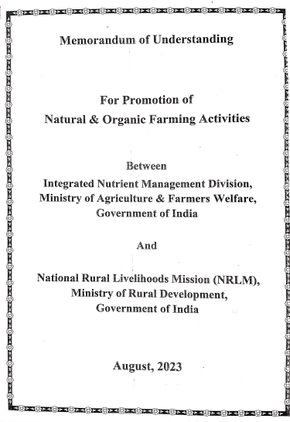
Resource Provisions- Other Ministry Schemes
PM Matsya Sampada Yojana, Ministry of Fisheries
A-HELP
Ministry of Animal Husbandary and dairy
Natural farming- Ministry of Agriculture
Resource Provisions
Convergence
Examples
Questions

Slide 8
Resource Provisions- Other Ministry Schemes
Department | Initiatives
Indian Council of Agricultural Research (ICAR) | Training and capacity building of identified extension associates. Promotion of technology demonstration centres, Integrated Farming Systems, and field. Infrastructure and working capital support in the IFS.
Department of Animal Husbandry and Dairying (DAHD) | Promoting entrepreneurship in poultry, sheep, goats, pigs, and fodder production. Promoting Farmer Producer Organizations (FPOs) under the Animal Husbandry Infrastructure Fund (AHIDF): Credit support for dairy processing and value addition. Promoting dairy activities through village Dairy Societies, and establishing links with milk unions for market access. Development of common facilities centres and VDK.
Resource Provisions
Convergence
Examples
Questions

Slide 9
Resource Provisions- Other Ministry Schemes
Department | Initiatives
Tribal Cooperative Marketing Development Federation of India (TRIFED), Ministry of Tribal Affairs (MoTA) | Procurement of Minor Forest Produces (MFPs). Empanelment of tribal SHGs and Producers Collectives for product sales through TRIBES INDIA outlets. Access to TRIFED's platforms for market access.
National Highways Authority of India (NHAI), Ministry of Road Transport and Highway, GoI | Sustainable income source for SHG members and its federations through plantation activities alongside the highways and lands of NHAI
National Centre for Organic and Natural Farming. | Promotion of Organic and Natural Farming. Promotion of PGS for Organic Certification. Promotion of on farm bio input production.
Ministry of Food Processing Industries | Promotes food processing businesses, Enhances food safety and quality standards, Provides financial assistance and capacity building under PMFME and SFURTI scheme.
Resource Provisions
Convergence
Examples
Questions

Slide 10
Scope for convergence:
Scheme | Benefits for HHs
Pradhan Mantri Kisan Samman Nidhi (PM-KISAN) | Direct income support to small and marginal farmers, ₹6,000/year in three instalments, Financial aid for agricultural activities
Kisan Credit Card Scheme | Access to affordable credit for farming activities, Flexible repayment options, Interest subsidy for prompt repayments
Rashtriya Krishi Vikas Yojana (RKVY) | Promotes agricultural development, Funding for infrastructure, seeds, and post-harvest management, Skill development for farmers
Pradhan Mantri Fasal Bima Yojana (PMFBY) | Crop insurance for farmers against natural calamities, Premium subsidy for farmers, Timely compensation for crop loss
Pradhan Mantri Annadata Aay Sanrakshan Abhiyan (PM-AASHA | Ensures Minimum Support Price (MSP) for crops, Price support and procurement of agricultural produce, Protects farmers from price fluctuations
Resource Provisions
Convergence
Examples
Questions

Slide 11
Scope for convergence:
Scheme | Benefits for HHs
Pradhan Mantri Mudra Yojana (PMMY) | Access to collateral-free loans for micro and small enterprises,Three categories: Shishu, Kishor, Tarun, Encourages entrepreneurship
Ayushman Bharat Pradhan Mantri Jan Arogya Yojana | Health insurance for vulnerable families, Cashless treatment at empanelled hospitals, Covers hospitalization expenses and pre-existing diseases
National Digital Literacy Mission (NDLM) | Promotes digital literacy in rural areas, Training on digital devices and internet usage, Empowers individuals to access online services
Resource Provisions
Convergence
Examples
Questions

Slide 12
Scope of convergence: Agriculture & Horticulture
Irrigation and Water Resources
  Pradhan Mantri Krishi Sinchayee Yojana (PMKSY) - MoAFW
  National Mission for Sustainable Agriculture (NMSA) - MoAFW
  Mission for Integrated Development of Horticulture (MIDH) - MoAFW
  National Food Security Mission (NFSM) - MoAFW
  Bringing Green Revolution to Eastern India (BGREI) - MoAFW
  Command Area Development and Water Management (CAD&WM) - MoJS
  Atal Bhujal Yojana (ATAL JAL) - MoJS
  National Agricultural Development Programme(NADP) - MoAFW
  National Mission on Agricultural Extension and Technology (NMAET) - MoAFW
  National Food Security Mission (NFSM) - MoAFW
  National Mission on Oilseeds and Oil Palm (NMOOP) - MoAFW
  Parampragat Krishi Vikas Yojana (PKVY) - MoAFW
  PM-Kusum - MoAFW
  Jaivik Krishi Protsahan Yojna (JKPY) - MoAFW
  National Mission on Sustainable agriculture (NMSA) - MoAFW
  Sub-Mission on Agricultural Mechanization (SMAM) - MoAFW
  Krishi Vigyan Kendra (KVK) - MoAFW
  Mahatma Gandhi National Rural Employment Guarantee Act -MoRD
  Mission for Integrated Development of Horticulture (MIDH) - MoAFW
Agriculture Extension
Resource Provisions
Convergence
Examples
Questions

Slide 13
Scope of convergence: Agriculture & Horticulture
Credit and Insurance
Market Access
E Nam
Pradhan Mantri Annadata Aay SanraksHan Abhiyan (PM-AASHA)
10000 FPO scheme
Venture capital scheme
Equity Grant and Credit Guarantee Fund Scheme For Farmer Producer Companies(EGCGFS)
Dhaanya Lakshmi Scheme
Producers Organisation Development Fund (PODF)
Mission for Integrated Development of Horticulture (MIDH)
National Mission for Sustainable Agriculture (NMSA)
Pradhan Mantri Fasal Bima Yojana(PMFBY)
Kisan Credit Card (KCC)
Interest Subvention scheme
National Agriculture Infra Financing Facility
Food Processing
SAMPADA
Production Linked Incentive Scheme for Food Processing Industry (PLISFPI)
PM Formalisation of Micro Food Processing Enterprises Scheme (PMFME)
Operations Green
Resource Provisions
Convergence
Examples
Questions

Slide 14
Scope of convergence: Animal Husbandry
Livestock Extension
Credit and Insurance
  National Livestock Mission (NLM)
  Dairy Entrepreneurship Development Scheme
  Dairy Processing and Infrastructure Development Fund (DIDF)
  National Animal Disease Control Programme
  Livestock Health and Disease Control (LH & DC)
  Animal Husbandry Infrastructure Development Fund (AHIDF)
Asset development
FPO Promotion
  National Programme for Bovine Breeding and Dairy Development (NPBBDD)
  Mahatma Gandhi National Rural Employment Guarantee Act
  Blue Revolution
  Fisheries and Aquaculture Infrastructure Development Fund (FIDF)
  Pradhan Mantri Matsya Sampada Yojana
  National program for dairy development
  Supporting Dairy Cooperatives and Farmers Producers Organization engaged in dairy activity (SDCFPO)
Resource Provisions
Convergence
Examples
Questions

Slide 15
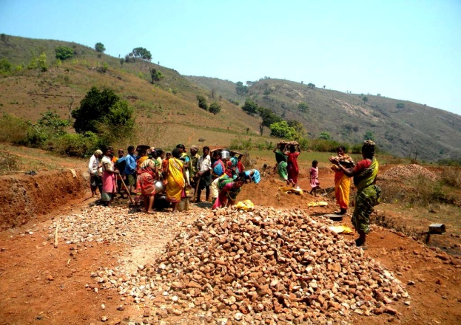
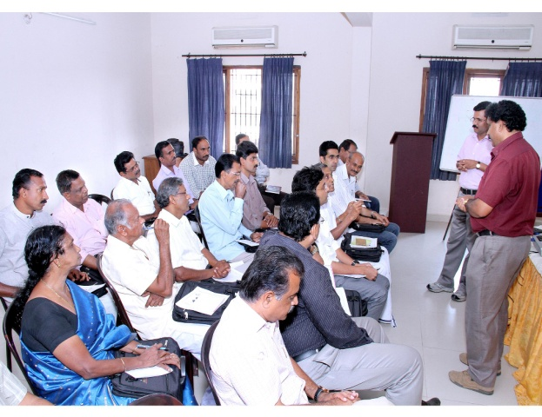
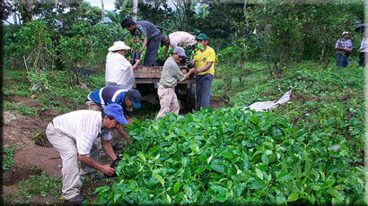
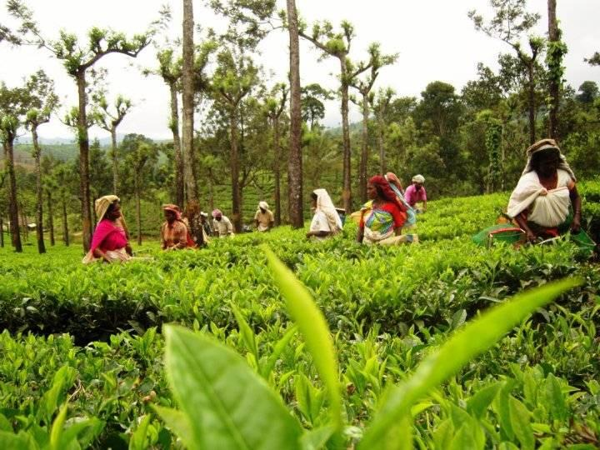

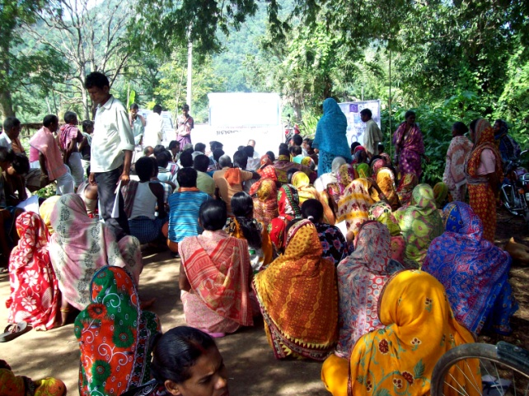
Examples of Convergence – Coffee Plantation
Training & Technology:
Coffee Board/NRLM
Coffee Plants:
Nursery of Horticulture Dept.
Land Development:
MGNREGS
Maintenance: Beneficiaries/ATMA
Coffee Plantation (Tribal area)
Village Organisations: Payments(MGNREGS)
Resource Provisions
Convergence
Examples
Questions

Slide 16
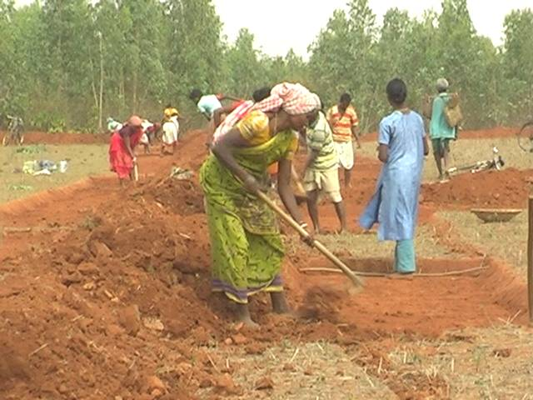
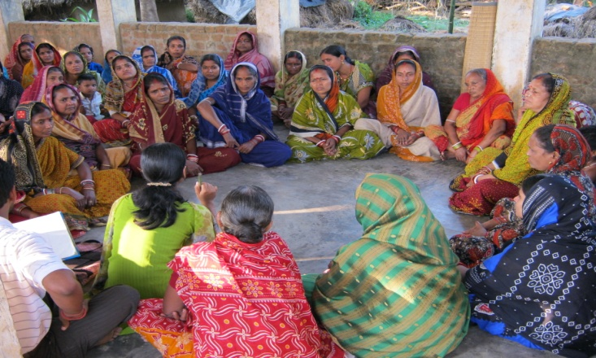
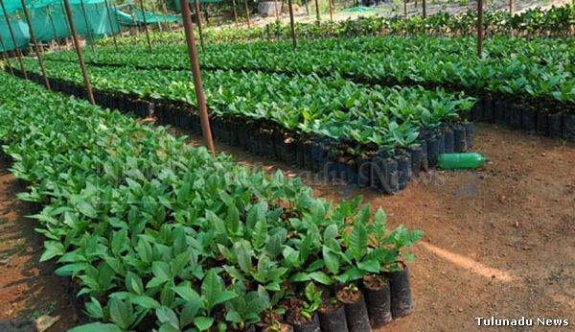
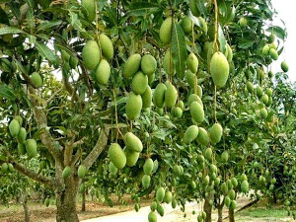
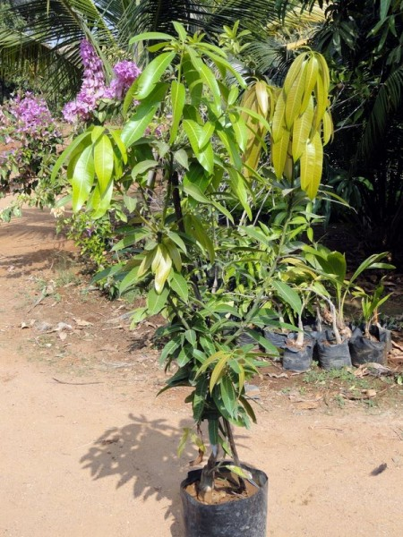
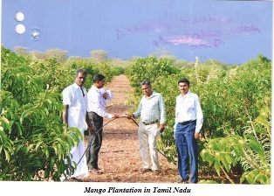
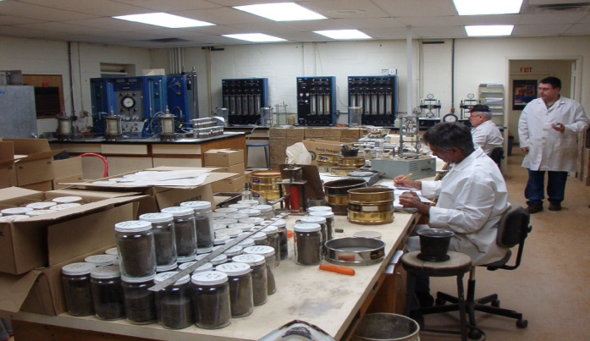
Examples of Convergence – Mango Plantation
Land Development
MGNREGS
Maintenance SHG
Cost of Plants
National Hort. Mission
Tech. Supervision
Horticulture Dept.-RKVY/NHM
Mango Orchard
Technology & Supply of Plants
Agl. University-ATMA/RKVY
Soil testing
Local Lab, Soil and Conservation Dept.(NHM)
Resource Provisions
Convergence
Examples
Questions

Slide 17




Examples of Convergence – Pomegranate
Land Preparation
PKVY/ MGNREGS
Green House structures
MIDH
Net House
MIDH
Nursery preparation
MIDH
Irrigation
PMKSY
MIDH
.
Resource Provisions
Convergence
Examples
Questions

Slide 18
Thank you

Slide 19
MGNREGS Convergence
Dep. | Works
MGNREGS | Category A : Public Works Relating to Natural Resources Management Water conservation and water harvesting structures. Watershed management: contour trenches, terracing, contour bunds, boulder checks, gabion structures. Micro and minor irrigation works and creation, renovation and maintenance of irrigation canals and drains. Renovation of traditional water bodies. Afforestation, tree plantation and horticulture in common and forest lands. Land development works in common land Category B : Individual Assets for Vulnerable Sections (Only for Households in Paragraph 5 of Schedule I) infrastructure for irrigation including dug wells, farm ponds and other water harvesting structures. Improving livelihoods through horticulture, sericulture, plantation, and farm forestry. Livestock Promotion: poultry, goat, piggery, and cattle shelter and fodder troughs for cattle. Promotion of fisheries such as, fish drying yards, storage facilities Category C : Common Infrastructure for DAY -NRLM Compliant Self-Help Groups Common worksheds for livelihood activities of self-help groups. (ANG, Nursery, etc.) infrastructure for bio-fertilisers and post-harvest facilities including pucca storage facilities for agricultural produce Category D : Rural Infrastructure Construction of buildings for women self-help groups’ federations.
Resource Provisions
Convergence
Examples
Questions

Slide 20
Questions
Q.1. Name the Scheme that provides financial assistance for Poultry Shed/ Goat Shed/ Cattle Shed etc?
Q.2. If you want to buy a Irrigation Pump, which Department can be approached?
Q.4. If you want to take loan for small enterprise, through which scheme you can apply for?
Q.5. Under Which scheme cold chain infrastructure can be created?
Resource Provisions
Convergence
Examples
Questions

Slide 21
Schemes for livelihood convergence with line departments
National Beekeeping and Honey Mission- Providing support to bee keepers by providing them assets
Pradhan Mantri Krishi Sinchai Yojana- Support different forms of irrigation including drip irrigation, sprinkler etc for farming
Pradhan mantri matsya sampadana yojana- support fishery intervention
KCC for animal husbandry and fisheries- upto 3 lakh credit as working capital in dairy and fisheries
Pradhan Mantri Kisan Samman Nidhi- Rs 6000 per annum support to farmers in 3 installments
Agricultural infrastructure fund- around 3% Interest subvention in credit under existing or future government schemes

Slide 22
Schemes of MoRD

Slide 23
Resource Provisions- DAY-NRLM
Financial Inclusion | Institution Building and Capacity Building
Bank Linkage Women Enterprise Fund - Collateral free Bank Loan up to 10 Lakhs for SHG Members (interest subvention of 2% for loan up to ₹ 1.5 lakh up to 3 Years) Collateral Free Loan to SHGs (Up to Rs.20 Lakh) Interest Subvention (Up to Rs 3 Lakh loan @ 7% RoI) | Model Cluster Level Federations Capitalization support (₹ 1.5 lakh/SHG)
Resource Provisions
Convergence
Examples
Questions

